Slide 1

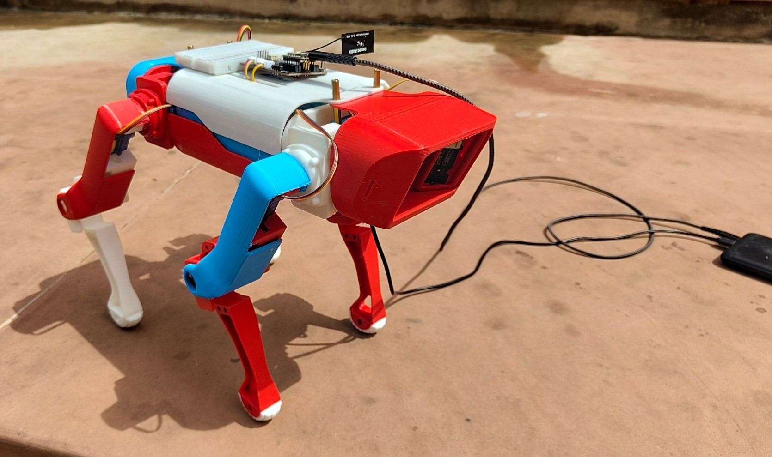
PROJECT I · FINAL REVIEW
Precision Agriculture Monitoring Quadruped Robot Dog
A 3D-printed quadruped carrying wireless crop-health sensing, with leaf-disease classification and physics-validated locomotion
Adithya Sankar Menon · 23BRS1079
Siddhesh Pushkraj Shinde · 23BCE5048
Rachit Gupta · 23BCE1658
Guide: Dr. Lakshmanan K · 54758
Notes:
[30 s]
Good morning. We are Adithya, Siddhesh and Rachit, and our guide is Dr. Lakshmanan K.
Our project is a low-cost quadruped robot for precision agriculture. It is 3D-printed, it carries wireless sensors for crop-level air quality, a camera for leaf-disease detection, and its walking was designed and validated in a physics simulator before we powered the real servos.
In one line: the sensing payload works end to end, the gait works in simulation with real servo limits, and the real robot now stands and moves its legs.

Slide 2






How This Review Is Organised
01
Domain and Problem
Crop-loss context, monitoring platforms, 18-paper survey, research gaps, objectives
Slides 3–8
02
Methodology and Design
Workflow, design decisions, architecture, data flow, algorithms, locomotion model
Slides 9–19
03
Completion and Integration
Scope delivered, assembled robot, integrated dashboard, stable logging, live demo
Slides 20–25
04
Testing and Results
Bench tests, classifier validation, hardware actuation, simulated survey, speed limit
Slides 26–33
05
Innovation and Relevance
Contributions, cost and feasibility, ethics, practical use, limitations, future work
Slides 34–40
06
Conclusion and Q&A
Key takeaways, references, questions
Slides 41–43
Notes:
[30 s]
We have organised the talk around the six criteria of the panel rubric, so you can find the evidence for each one.
Section 1 is the domain and the problem. Section 2 is our methodology and design: architecture, data flow and the algorithms. Section 3 shows what was completed and how it fits together, and ends with the live demo. Section 4 is testing and results, from the hardware and from the simulation. Section 5 covers what is new, cost, ethics and practical use, along with limitations and future work. Section 6 concludes.
The slide numbers on the right show where each section is.

Slide 3

Domain and Problem
01
Why crop-level monitoring matters, what existing platforms miss, and what this project set out to do
Notes:
[5 s]
Let us start with the problem and why it matters.

Slide 4




Crop Disease Is Costly, and Often Seen Too Late
Drones see only the canopy top
20–40 %
Short flights; no view of leaf undersides or the air between rows
of global crop production is lost to plant pests and diseases every year (FAO)
Wheeled rovers get stuck
Lose traction in mud, soft soil and narrow furrows
Fixed IoT nodes leave gaps
10–28 %
25–41 %
20–41 %
Stationary sensors cover only the spot where they stand
Wheat
Rice
Maize
Yield losses to pathogens and pests, global estimate (Savary et al., 2019)
Research robots cost too much
Legged platforms such as ANYmal cost far beyond a small farm's budget
Notes:
[50 s]
The FAO estimates that 20 to 40 percent of global crop production is lost to pests and diseases every year. A field study by Savary and colleagues, covering five staple crops in 67 countries, put the losses at 10 to 28 percent for wheat, 25 to 41 percent for rice and 20 to 41 percent for maize.
Much of this damage is preventable if disease is caught early, and early detection needs close, frequent observation at crop level. The platforms used today each fall short in a different way:
- Drones fly over the canopy. They have short flight times and cannot see leaf undersides or sample the air between rows.
- Wheeled rovers lose traction in mud, soft soil and narrow furrows.
- Fixed IoT sensor nodes measure only the spot where they stand.
- Legged research robots like ANYmal can handle the terrain, but they cost far more than a small farm can afford.
If asked:
- "Why does air quality matter for crops?" Stressed and diseased plants change the volatile organic compounds they emit, so a rise in VOCs near a plant can be an early warning sign before symptoms are visible.

Slide 5
Which Platform Can Monitor Between Crop Rows?
A legged robot can walk between rows and carry sensors to the leaves; the question is whether it can be built cheaply.
Platform | Close-range, leaf-level sensing | Moves on soft soil and in furrows | Covers the whole field | Affordable for small farms
Drone | ✗ | ✓ | ✓ | ~
Wheeled or tracked rover | ✓ | ✗ | ~ | ~
Fixed IoT sensor nodes | ~ | — | ✗ | ~
Research quadruped (ANYmal, Cheetah 3) | ✓ | ✓ | ✓ | ✗
This project: printed quadruped | ✓ | ✓ | ✓ | ✓
✓ suited ~ partly ✗ not suited
Notes:
[40 s]
This table compares the platforms on four needs: sensing close to the leaves, moving on soft soil and in furrows, covering the whole field, and being affordable for a small farm.
Each existing option fails at least one. Drones cannot sense at leaf level. Rovers cannot handle furrows. Fixed nodes cannot cover the field. Research quadrupeds tick every box except cost.
A legged robot walks where a farmer walks: it places each foot, so it can step between plants and over furrows. The question our project tackles is whether a legged monitoring robot can be built cheaply, with printed parts and hobby servos, and still work.
If asked:
- "Is this table measured?" No. It is a qualitative summary drawn from the literature on the next slide.

Slide 6


What 18 Papers Tell Us
Legged locomotion [1–6]
Field robots and drones [7–10]
MIT Cheetah 3, Mini Cheetah, ANYmal, Stanford Doggo; MPC and learned gaits
Reviews of agricultural rovers, drone–ground teaming, farmer interfaces
Gap Custom actuators, costly; none carries a crop-sensing payload
Gap Wheels fail in mud and furrows; drones cannot see under the canopy
Leaf-disease deep learning [11–15]
IoT environmental sensing [16–18]
CNNs reach 97–99 % on PlantVillage; MobileNetV2 is efficient enough for edge use
Layered IoT and sensor networks for microclimate, gases and soil
Gap Lab images only; closed-set models label anything they see
Gap Stationary nodes leave gaps; nothing carries sensors along rows
Notes:
[60 s]
We surveyed 18 papers in four groups. The full table is in the backup slides at the end.
- Legged locomotion, papers 1 to 6: MIT Cheetah 3, Mini Cheetah, ANYmal and Stanford Doggo show what legged robots can do, using custom actuators and controllers such as model-predictive control and learned policies. None of them carries an agricultural payload, and most are very expensive.
- Field robots and drones, papers 7 to 10: wheeled rovers fail in mud and soft soil, and drones cannot see under the canopy.
- Leaf-disease deep learning, papers 11 to 15: CNNs reach 97 to 99 percent accuracy on the PlantVillage dataset, and MobileNetV2 is efficient enough for low-power devices. But the images are lab photos on plain backgrounds, and these models are closed-set: they will label anything they see as one of their diseases.
- IoT sensing, papers 16 to 18: these use stationary sensor nodes, which leave coverage gaps.
If asked:
- "Which paper is closest to your work?" Saleem et al. conclude that field-ready disease detection needs ground robots that bring the camera close to the leaves, which is what our robot does.

Slide 7
Research Gaps and How This Project Answers Them
Gap in the literature
Our response
Low-cost legged robots have not carried an environmental and imaging payload, and their feasibility with hobby servos is rarely quantified
A printed 12-DOF quadruped with two sensing nodes, and a physics model with the real MG996R torque limit
Crop sensing relies on fixed nodes; a mobile, low-cost platform logging gas, dust and temperature along the rows is missing
A wireless sensor node on the robot reporting every 5 s to a logging dashboard
Disease classifiers are closed-set and report a disease for any input, even a wall
A vegetation gate that checks for leaf before the classifier is allowed to answer
Hobby quadruped designs give no guidance on centre of mass or the speed servos allow
Measured: centre of mass 12 mm aft, trot limited to about 0.18 m/s
Notes:
[50 s]
From the survey we identified four gaps. Each has a direct answer in our build.
1. Low-cost legged robots have not carried a crop-sensing payload, and nobody has quantified whether hobby servos are strong enough. We built a printed 12-servo quadruped with two sensing nodes, and a physics model that uses the real MG996R torque limit.
2. Crop sensing relies on fixed nodes. We put a wireless sensor node on the robot that reports every five seconds to a logging dashboard.
3. Disease classifiers are closed-set and will report a disease for a photo of a wall. We added a vegetation gate that checks there is a leaf before the classifier is allowed to answer.
4. Hobby quadruped designs give no guidance on centre of mass or the speed servos allow. We measured both: the centre of mass sits 12 millimetres behind the body centre, and the trot is limited to about 0.18 metres per second.

Slide 8


Objectives and Scope
Mobility
Sensing
Plant-health AI
Live dashboard
A low-cost printed 12-DOF quadruped whose gait is validated against real servo torque limits, then tested on the robot
Gas (TVOC, eCO₂), dust, temperature and range sensing carried on the chassis
Leaf-disease classification that first checks a leaf is in view
Wireless logging, live charts, and leaf images tagged with the readings at capture
In scope
Printed platform, sensing and camera nodes, dashboard and classifier, locomotion design, simulation, first actuation trials
Out of scope
Trials on a working farm, sensor calibration against reference instruments, training a new classifier, GPS mapping
Notes:
[40 s]
We had four objectives:
- Mobility: a low-cost printed quadruped whose gait is validated against real servo limits, then tested on the robot.
- Sensing: gas, dust, temperature and range on the chassis.
- Plant-health AI: leaf-disease classification that first checks a leaf is in view.
- A live dashboard: logging, live charts, and leaf images tagged with the air readings at the moment of capture.
In scope: the printed platform, both sensing nodes, the dashboard and classifier, the locomotion design and simulation, and the first actuation trials on the robot.
Out of scope: trials on a working farm, calibrating the sensors against reference instruments, training our own classifier, and GPS mapping.

Slide 9

Methodology and Design
02
How the system was designed: the workflow, key technical decisions, architecture, data flow and algorithms
Notes:
[5 s]
Now the methodology and technical design.

Slide 10






Methodology: Analyse, Revise, Build, Validate
01
02
03
04
05
06
Analyse
Revise
Build sensing
Build software
Simulate
Validate
Torque, power and heat analysis of the Review III plan
Move inference to a laptop; split sensing over two ESP32 nodes
Sensor node and camera firmware, wiring with dividers
Flask dashboard, logging, gated classifier
Kinematics and gait in MuJoCo with real servo limits
Bench tests, logged sessions, scans, leg actuation
Guiding principle Every design change came from a measurement or analysis: supply and heat limits, servo torque margin, camera interface, and faults found on the bench.
Notes:
[50 s]
We worked in six steps.
1. Analyse. We analysed the Review III plan for torque, power and heat, and found problems.
2. Revise. We moved inference off the robot to a laptop, and split sensing across two inexpensive ESP32 boards.
3. Build sensing. We wrote the sensor-node and camera firmware and wired the sensors through voltage dividers.
4. Build software. We built the Flask dashboard, the logging, and the gated classifier.
5. Simulate. We derived the leg kinematics and developed the gait in MuJoCo, with the servos limited to their real torque, before risking the hardware.
6. Validate. Bench tests, logged sessions, camera scans and leg actuation on the real robot.
The guiding principle was that every design change had to come from a measurement or an analysis, not a guess.

Slide 11
Key Technical Decisions Since Review III
Review III plan | Final system | Reason
Jetson Orin Nano on the robot | XIAO ESP32-S3 and ESP32-CAM nodes; inference on a laptop | Needs 9–19 V and dissipates 7–25 W inside a PLA body; a fall risks an expensive board
IMX219 CSI camera | ESP32-CAM (OV3660), MJPEG over Wi-Fi | The ESP32-S3 has no MIPI-CSI camera interface
ROS 2 and MQTT on the robot | HTTP and JSON to a Flask dashboard | Fewer parts; every device on one local network
Gazebo dynamics model | MuJoCo physics model | The Gazebo stance never stabilised; MuJoCo walks and reports metrics
3S LiPo and onboard regulators | USB power bank for the nodes; separate supply for servos | Safer and simpler for bench work
Walking trials on hardware | Gait in simulation first, then leg actuation on the robot | Simulation showed a centre-of-mass correction is needed
Notes:
[60 s]
These are the main changes since Review III, with the reason for each.
- The Jetson Orin Nano is gone. It needs a 9 to 19 volt supply and dissipates 7 to 25 watts inside a PLA body, which softens near 60 °C. It also barely fitted the bay, and a fall would put an expensive board at risk. Inference now runs on a laptop, which needs no GPU for one image at a time.
- The IMX219 CSI camera was replaced, because the ESP32-S3 has no MIPI-CSI interface. We use an ESP32-CAM that streams over Wi-Fi.
- ROS 2 and MQTT were replaced with plain HTTP and JSON to a Flask server. That means fewer moving parts, with all devices on one local network.
- Gazebo was replaced with MuJoCo. In Gazebo the robot never held a stable stance, while MuJoCo models torque-limited servos directly.
- The LiPo battery came off the robot for safety during bench work.
If asked:
- "Isn't this a step back from onboard AI?" For monitoring, a few images a minute is enough, and the laptop does that in under 100 milliseconds with no risk to the hardware.

Slide 12


System Architecture
Sensor node
Laptop base station
Camera node
XIAO ESP32-S3 + expansion board
Hotspot 192.168.137.1
ESP32-CAM, OV3660 sensor
SGP30 gas · I²C 0x58
MCP9808 temperature · I²C 0x18
PPD42 dust · D0
HC-SR04 × 2 · D6–D9
OLED, buzzer, button
Flask dashboard on port 5000
CSV log of every reading
Vegetation gate + MobileNetV2
Relays video to all viewers
MJPEG video on port 81
Single photo on port 80
Registers itself at boot
JSON every 5 s
MJPEG video, 16–20 fps
Platform SpotMicro-based printed chassis carrying both nodes · 12 × MG996R servos · gait validated in MuJoCo · any phone on the hotspot can open the dashboard
Notes:
[50 s]
There are three parts, all on one Wi-Fi hotspot hosted by the laptop, which always takes the address 192.168.137.1.
- The sensor node is a Seeed XIAO ESP32-S3 on its expansion board. It reads the SGP30 gas sensor and the MCP9808 temperature sensor over I2C, the PPD42 dust sensor on a digital pin, and two ultrasonic sensors. It has its own OLED screen, buzzer and button, and posts a JSON record every five seconds.
- The camera node is an ESP32-CAM with an OV3660 sensor. It streams Motion-JPEG video on port 81, serves single photos on port 80, and registers itself with the dashboard at boot.
- The laptop runs the Flask dashboard: it logs every reading to CSV, runs the classifier, and relays the video to every viewer.
The robot carries only two cheap microcontrollers, and all the heavy computation is on the laptop. Any phone on the hotspot can open the dashboard.

Slide 13







Data Flow: From Sensor to Tagged Diagnosis
Sensor stream
Sample: gas 1 s, temperature 2 s, dust 30 s
Post JSON to /api/sensors every 5 s
Grade good / moderate / high
Log to daily CSV, update live cards
Camera stream
ESP32-CAM streams MJPEG
Dashboard relays frames to every viewer
Scan: vegetation gate, then MobileNetV2
Save image tagged with crop, condition and readings
Notes:
[50 s]
There are two data streams.
Sensor stream:
1. The node samples gas every second, temperature every two seconds, and dust over 30-second windows.
2. Every five seconds it posts a JSON record to /api/sensors on the laptop.
3. The dashboard grades each reading good, moderate or high.
4. It appends the reading to a daily CSV file and updates the live cards.
Camera stream:
1. The ESP32-CAM streams Motion-JPEG.
2. The dashboard holds one connection to the camera and relays frames to every browser, so extra viewers add no load on the camera.
3. On a scan, the frame goes through the vegetation gate and then MobileNetV2.
4. The image is saved with a banner showing crop, condition and confidence, together with the sensor readings at that moment.
That last step is the link between plant health and the environment around the plant.

Slide 14
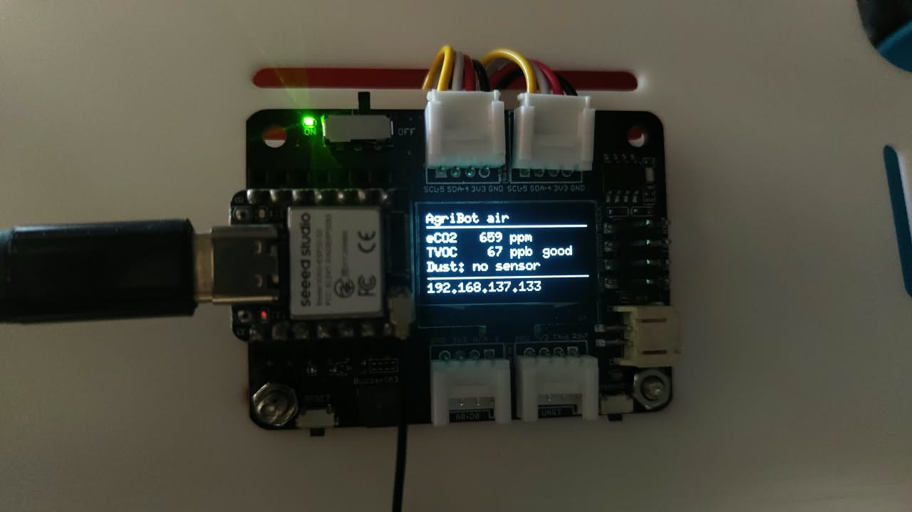
Sensor Node Hardware
Sensor | Measures | Interface | Status
SGP30 | TVOC, eCO₂ | I²C 0x58 | Live
MCP9808 | Temperature, ±0.25 °C | I²C 0x18 | Live
PPD42 | Particles > 1 µm | D0, via divider | Live
OLED, buzzer, button | Display and alerts | On board | Live
Live readings and IP address on the node's OLED
5 V → 3.3 V safely
Every 5 V sensor output reaches the XIAO through a 1 kΩ / 2 kΩ divider: 5 V becomes 3.33 V, and the PPD42's 4 V becomes 2.67 V.
Ultrasonic firmware is written and flashed; the sensors report as absent until connected.
Notes:
[45 s]
This is the sensor node, with live readings and its IP address on the OLED.
The table shows each sensor:
- The SGP30 for TVOC and eCO2, the MCP9808 for temperature, and the PPD42 dust sensor are all live.
- The ultrasonic sensors have complete firmware but are not wired on this build. In the simulation they are what detects the end of each row.
One electrical detail matters here. The XIAO's pins tolerate only 3.3 volts, but the PPD42 outputs about 4 volts and the ultrasonic echo is 5 volts. So each of those signals goes through a 1 kΩ / 2 kΩ divider, which brings 5 V down to 3.33 V and 4 V down to 2.67 V, still a clean logic high.
If asked:
- "Why is the SGP30 read every second?" Its on-chip baseline compensation expects a 1 Hz read rate, and its first 15 seconds are flagged as warm-up.
- "eCO2 versus real CO2?" eCO2 is estimated from VOCs; it is not a true CO2 measurement.

Slide 15


Firmware Algorithms
Dust by low-pulse occupancy
Absent-sensor detection
Temperature-corrected range
An interrupt times the PPD42's low pulses over 30 s. C = 1.1r³ − 3.8r² + 520r + 0.62 particles per 0.01 ft³
An unplugged PPD42 read as 1.1 million particles. No edges and a low line now means absent
c = 331.3 + 0.606·T m/s from the MCP9808; a fixed 343 m/s is ~3 % off at 35 °C
Crosstalk-free ultrasonics
Wi-Fi diagnostics
Self-registering camera
The two HC-SR04s fire alternately, and each reading is a median of three
Reports why a link fails; traced −78 dBm to a missing antenna, −26 dBm once fitted
The ESP32-CAM sends its stream URL to the dashboard at boot, so a new IP needs no setup
Notes:
[60 s]
These are the firmware algorithms, several of which came from faults we found in testing.
- Dust. The PPD42 pulls its output low while particles pass its light beam. An interrupt on every edge measures the total low time over a 30-second window. The low percentage r goes into the manufacturer's curve, C = 1.1 r³ − 3.8 r² + 520 r + 0.62 particles per 0.01 cubic foot.
- Absent-sensor detection. With the PPD42 unplugged, the pin read low for the whole window, and the curve reported 1.1 million particles and sounded the alarm. Now a window with no edges and a low line is reported as "absent", and the pin has a pull-down.
- Range. Range uses the speed of sound corrected for temperature, c = 331.3 + 0.606 T. A fixed 343 m/s would be about 3 percent off at 35 °C.
- Ultrasonic crosstalk. The two ultrasonic sensors fire alternately so neither hears the other's ping, and each reading is a median of three.
- Wi-Fi diagnostics. These traced a weak −78 dBm link to a missing antenna; with the antenna fitted it reads −26 dBm.
- Camera self-registration. The camera announces its own address to the dashboard, so a new IP needs no setup.

Slide 16
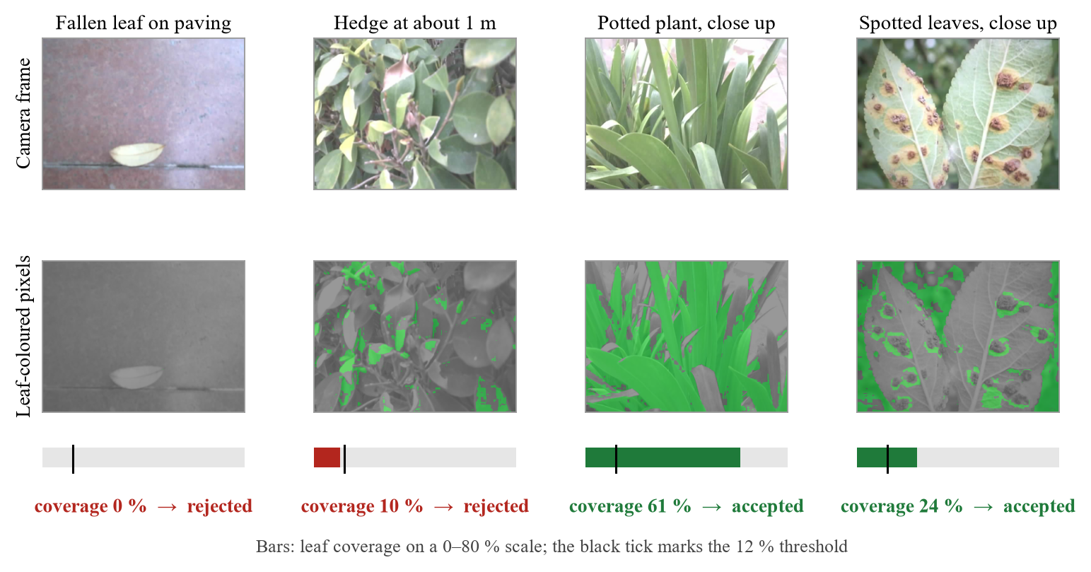




Gated Leaf-Disease Classification
Frame from the ESP32-CAM
Vegetation gate: share of pixels with 38° ≤ H ≤ 165°, S ≥ 0.20, V ≥ 0.12; below 12 % → no leaf
MobileNetV2 trained on PlantVillage: 38 classes, 14 crops
Top probability below 50 % → reported as uncertain
The gate on four outdoor camera frames: leaf-coloured pixels in green
Image saved and tagged with crop, condition and the readings
Notes:
[60 s]
This is the classification pipeline.
The classifier is MobileNetV2 fine-tuned on PlantVillage, with 38 classes across 14 crops. It is closed-set: it has no "not a leaf" answer. When we pointed the camera at an empty room, it said "orange, citrus greening" with 82 to 90 percent confidence.
So we added a vegetation gate before the classifier. The frame is shrunk to 160 by 120 pixels and converted to HSV. A pixel counts as leaf-coloured if its hue is between 38 and 165 degrees (green through the yellow of sick leaves), its saturation is at least 0.2, and its value is at least 0.12. If less than 12 percent of the frame is leaf-coloured, we report "no leaf in view" and hide the model's answer.
The four frames on the right:
- A fallen dry leaf is rejected at 0 percent.
- A hedge seen from a metre away is rejected at 10 percent.
- A close-up plant is accepted at 61 percent.
- Spotted leaves are accepted at 24 percent. The brown lesions don't count as leaf-coloured, but the green tissue around them keeps diseased leaves above the threshold.
After the gate, a top probability below 50 percent is reported as uncertain.

Slide 17
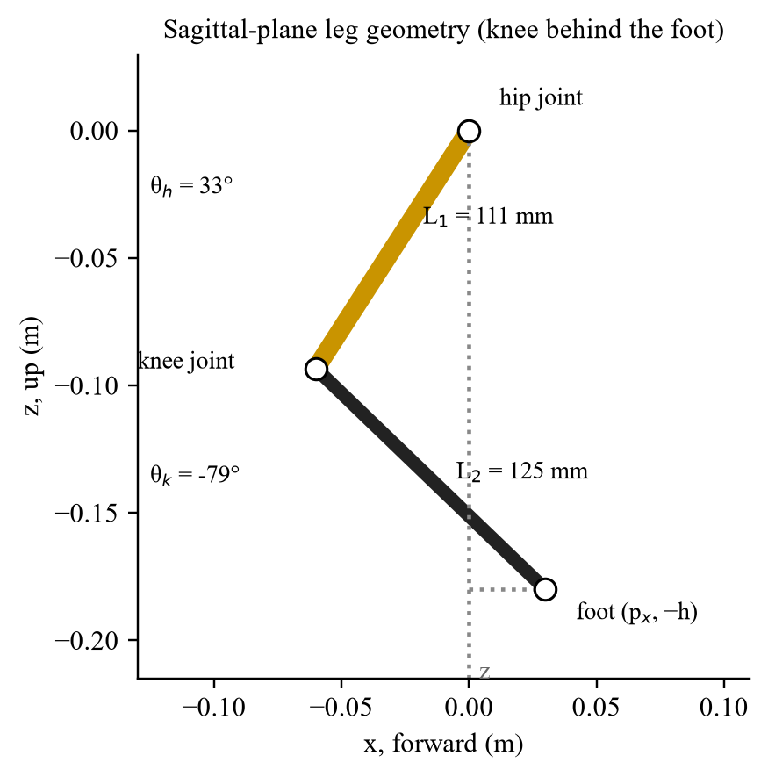
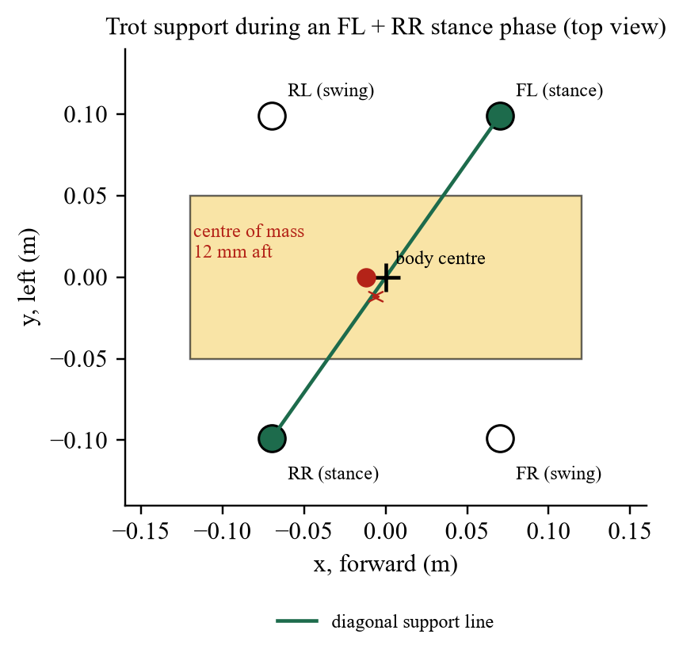


Locomotion Design: Kinematics, Gait, Centre of Mass
Closed-form IK
Abduction, hip, knee from the foot target; verified at 1,280 targets, error < 10⁻⁷ m
Diagonal trot
2 Hz, duty 0.6, 30 mm step height, 180 mm body height, roll and pitch levelling
CoM-centred footholds
Feet placed around the measured centre of mass, 12 mm aft of the body centre
Leg geometry: femur 111 mm, tibia 125 mm
Trot support line passes in front of the centre of mass
Why footholds matter Centred on the body, the trot fell in all 24 gait settings; centred on the measured centre of mass, tilt stayed below 0.7°.
Notes:
[60 s]
For locomotion, each leg has three joints (abduction, hip and knee), with measured femur and tibia lengths of 111 and 125 millimetres.
- Inverse kinematics. We derived the closed-form inverse kinematics: given a foot target, it returns the three joint angles directly. We checked it against MuJoCo's own forward kinematics at 1,280 targets, and the worst error was below 10⁻⁷ metres, which is effectively exact.
- Gait. The gait is a diagonal trot at 2 hertz with a duty factor of 0.6. Feet lift 30 millimetres in a raised-cosine swing, and the body height is 180 millimetres. A levelling term uses roll and pitch to adjust leg heights.
- Centre of mass. All four knees point backward, so the legs' mass hangs behind the body centre, and the centre of mass ends up 12 millimetres aft. In a trot the robot stands on two diagonal feet, and the line between them passes through the body centre, in front of the centre of mass, so the robot tips backward. With footholds centred on the body, the trot fell in all 24 gait settings we tried. With footholds centred on the measured centre of mass, tilt stayed below 0.7 degrees.

Slide 18
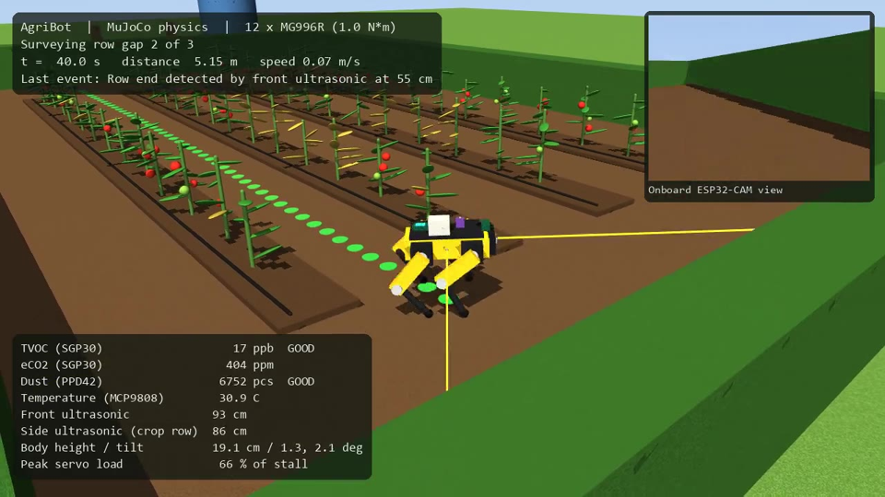



Simulation Model in MuJoCo
Measured geometry
140 × 78 mm hip spacing, 111 / 125 mm legs, 1.35 kg
Realistic servos
Position servos capped at 1.0 N·m (MG996R stall 0.92–1.08 N·m)
Modelled field
4 tomato rows, a stressed patch emitting VOCs, a dusty headland
Autonomous mission
Heading control; front range sensor ends each row at 55 cm
Autonomous survey: stand up, trot each row gap, detect the row end, turn, log readings
Gait chosen by a sweep 24 settings: frequency 2 / 2.5 / 3 Hz × duty 0.5 / 0.6 × stiffness 15 / 30 N·m/rad × levelling gain 0 / 0.5
Notes:
[45 s — play the clip]
This is our MuJoCo simulation.
- The robot is built from the measured geometry: 140 by 78 millimetre hip spacing, the measured leg lengths, 1.35 kilograms in total.
- Every joint is a position servo whose torque is capped at 1.0 newton-metre, between the MG996R stall values at 4.8 and 6 volts. So if the gait works here, it is not relying on unrealistic motors.
- The field has four rows of tomato plants, a patch of stressed plants that emits VOCs, and a dusty headland.
- The mission is autonomous. The robot stands up, trots down each row gap under heading control, and when the front ultrasonic reads under 55 centimetres it knows it has reached the hedge, turns, and starts the next row. Along the way it logs simulated gas, dust and temperature.
The gait parameters were chosen by sweeping 24 combinations of frequency, duty factor, servo stiffness and levelling gain.
If asked:
- "Why MuJoCo over Gazebo?" Its position actuators clamp torque the way a real servo does, and it ran stably and fast enough to sweep many settings.

Slide 19



Technology Stack
Hardware
Firmware
Dashboard and AI
XIAO ESP32-S3 + expansion board · ESP32-CAM (OV3660) · SGP30, MCP9808, PPD42, HC-SR04 × 2 · 12 × MG996R
Arduino-ESP32 core 3.3 · Adafruit SGP30 · U8g2 display · esp_http_server for MJPEG
Python · Flask · PyTorch · Hugging Face Transformers · MobileNetV2 (PlantVillage)
Simulation
Mechanical
Collaboration
MuJoCo 3 · NumPy · Matplotlib · headless video and metrics
SpotMicro base (CC-BY) · PLA+ and TPU · Python generators for the custom mounts
Git and GitHub: firmware, dashboard, simulation and print files in one repository
Notes:
[20 s]
Briefly, the stack:
- Firmware in C++ on the Arduino ESP32 core.
- The dashboard in Python with Flask, using PyTorch and Hugging Face Transformers for the model.
- MuJoCo, NumPy and Matplotlib for the simulation.
- The chassis is based on the SpotMicro design, credited under its Creative Commons licence, with Python scripts generating our custom mounts.
Everything is in one public GitHub repository with run instructions.

Slide 20

Completion and Integration
03
What was delivered, how the parts work together, and evidence of stable operation, followed by the live demo
Notes:
[5 s]
Next, what we completed and how it fits together.

Slide 21
Scope Delivered
5 / 6
Objective | Status | Evidence
Print and adapt the chassis; measure its geometry | Achieved | 35 parts printed; four custom parts; measured geometry
Wireless sensing payload, robust to faults | Achieved | Gas, dust, temperature live
Camera streaming and gated classification | Achieved | 16–20 fps; gate rejects non-leaf frames
Live dashboard with logging and tagging | Achieved | Logged sessions; tagged captures with readings
Verified kinematics; gait feasible in simulation | Achieved | IK error < 10⁻⁷ m; full survey, no fall
Walking on the physical robot | Partly | Legs actuate and it stands; no steps yet
objectives fully achieved
Notes:
[45 s]
Of six objectives, four are fully achieved and two partly.
Achieved:
- The chassis is printed and adapted, with its geometry measured.
- Camera streaming and gated classification work.
- The dashboard logs and tags.
- The kinematics are verified and the gait works in simulation.
Partly achieved:
- Sensing is complete for gas, dust and temperature. The ultrasonic sensors have firmware ready but are not wired.
- Walking on the physical robot: the legs move and it stands, but it cannot yet step.
We would rather show you these honestly than overstate them. Each has a clear next step, which we cover in future work.

Slide 22

The Assembled Robot
35 printed parts
SpotMicro base adapted for the payload; ~700 g PLA+ with TPU feet; ₹5,200 to print
Sensor node on the top cover
XIAO, breadboard and sensors, with the external antenna on a standoff
Camera in the head
ESP32-CAM looks out through the printed nose
No battery on board
Payload runs from a USB power bank beside the robot
The assembled robot standing outdoors
Notes:
[30 s]
This is the assembled robot.
- It has 35 printed parts, about 700 grams of PLA+ with TPU feet, at a printing cost of about ₹5,200.
- The sensor node and breadboard sit on the printed top cover, with the external Wi-Fi antenna raised on a standoff.
- The ESP32-CAM sits in the head and looks out through the printed nose.
- There is no battery on board: the payload runs from a USB power bank beside the robot, which is safer for bench work.

Slide 23
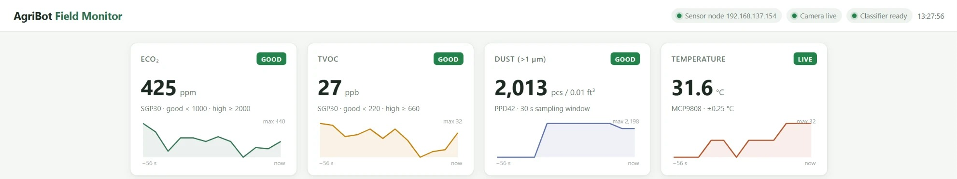
Integrated Dashboard
Dashboard on 18 October 2026: live eCO₂, TVOC, dust and temperature from the sensor node
Status bands
Logging
Camera and diagnosis
TVOC 220 / 660 ppb (German UBA guideline); eCO₂ 1,000 / 2,000 ppm; node marked offline after 15 s of silence
Every reading to a daily CSV; every scan saved as a tagged image with the readings at capture
Live MJPEG video, one-click scan or image upload, top three classes with confidence
Notes:
[40 s — then switch to the live dashboard]
This is the dashboard as it ran on 18 October, with live readings from the sensor node.
- Four cards show eCO2, TVOC, dust and temperature. Each has a status band and a short history chart. The TVOC bands of 220 and 660 ppb follow the German Federal Environment Agency guideline. If the node goes silent for 15 seconds it is marked offline.
- Every reading goes to a daily CSV file.
- The camera panel shows live video, a scan button and an image-upload fallback, and the diagnosis panel shows the top three classes.
I will show this live in the demo.

Slide 24
Stable Operation over Wi-Fi
321 + 199
readings in two sessions (28 and 17 min), no records lost
1,764 ppb
TVOC peak during exposure, back to baseline within tens of seconds
−26 to −60
dBm Wi-Fi signal throughout, ample for 5 s telemetry
Notes:
[45 s]
This chart shows stable operation.
It is a 17-minute session on 14 October, with TVOC logged every five seconds while we repeatedly exposed the gas sensor to VOC sources. The red and amber lines are the high and moderate bands. TVOC peaked at 1,764 ppb and fell back to baseline within tens of seconds after each exposure.
Across the two logged sessions, 28 and 17 minutes long, we recorded 321 and 199 readings with no records lost. The Wi-Fi signal stayed between −26 and −60 dBm, which is plenty for a reading every five seconds.
If asked:
- "What were the VOC sources?" Common household sources, such as breath and alcohol-based sanitiser, held near the sensor. The point is the response and recovery, not the absolute value.

Slide 25
Live Demonstration
1
Dashboard live
2
Breath test
Open http://192.168.137.1:5000; status pills show the sensor node, camera and classifier
Breathe on the SGP30: eCO₂ and TVOC rise within seconds and recover
3
Touch test
4
Leaf scan
Hold the MCP9808: temperature climbs about 3–4 °C
Show a leaf to the camera, then an empty scene: diagnosis versus no leaf in view
5
Simulation
6
Robot
Run the MuJoCo survey: rows, turns, TVOC trail over the stressed patch
Power the servos: the robot stands and moves its legs
Notes:
[demo, 4–6 min]
Now the live demo. The order:
1. Dashboard. Open 192.168.137.1:5000 and show the three status pills: sensor node, camera and classifier.
2. Breath test. Breathe on the SGP30: eCO2 and TVOC rise within seconds, then recover.
3. Touch test. Hold the MCP9808: the temperature climbs by 3 to 4 degrees.
4. Leaf scan. Hold a leaf to the camera and press Scan to show a diagnosis. Then point the camera away and scan again to show "no leaf in view".
5. Simulation. Run run_sim.bat to show the autonomous survey.
6. Robot. Power the servos to show it standing and moving its legs.
Backup plans:
- If the camera Wi-Fi is unreliable, use "Upload image" with a saved leaf photo.
- If the sensor node is offline, run fake_sensors.py to drive the dashboard.
Before the review:
- Turn on the laptop's Mobile Hotspot first, then power both boards.
- Give the ESP32-CAM its own power supply; it browns out when it shares one.

Slide 26

Testing and Results
04
Test procedures and measured results on the hardware, then the simulation metrics and their interpretation
Notes:
[5 s]
Now testing and results.

Slide 27
Bench Validation of the Hardware
Test procedure | Measured result | What it shows
Breathe on the SGP30 | eCO₂ 400 → 746 ppm, TVOC 0 → 210 ppb within 5 s; back to baseline | Gas sensing responds and recovers
Finger on the MCP9808 | 31.5 → 35.0 °C in about 10 s | Temperature tracks a real change
PPD42 in room air | 0–5,065 particles / 0.01 ft³ per 30 s window | Dust sensing live
PPD42 unplugged | Reported as absent instead of 1.1 million | No false alarms from wiring faults
Wi-Fi link of the XIAO | −78 dBm with time-outs → −26 dBm with antenna | Diagnostics found the fault
Camera video | ≈0.5 → 16–20 fps after moving to MJPEG | Live view usable for scanning
Servos, robot on its back | All four legs follow commanded angles | Wiring and servo control work
Servos, robot standing | Holds a stance and shifts its legs, slowly | Torque margin is thin, as predicted
Notes:
[60 s]
Every test applied a known change and checked the response. These numbers are measured on the real hardware.
- Breath on the SGP30: eCO2 went from 400 to 746 ppm and TVOC from 0 to 210 ppb within 5 seconds, then back to baseline.
- A finger on the MCP9808: 31.5 to 35.0 °C in about 10 seconds.
- The PPD42 in room air: 0 to 5,065 particles per 0.01 cubic foot, varying from one 30-second window to the next.
- With the PPD42 unplugged, it is now reported as absent instead of a false 1.1 million.
- Wi-Fi: −78 dBm with time-outs, and −26 dBm once the antenna was fitted.
- Camera video: from about 0.5 to 16–20 frames per second after we moved to MJPEG streaming.
- Servos: on its back, all four legs follow their commands. Standing, it holds a stance and shifts its legs, but slowly.

Slide 28
Classifier Validation: The Gate Prevents False Diagnoses
Without the gate
With the gate
82–90 %
Rejected
confidence for “citrus greening” on a photo of an empty room
0–0.1 % leaf coverage measured: “no leaf in view”, no diagnosis shown
12 / 12
8 / 10
30–80 ms
PlantVillage leaves accepted by the gate (27–76 % coverage)
spot-check images classified correctly above 92 %; 1 uncertain, 1 wrong
inference per image on the laptop CPU
Notes:
[50 s]
This is the key result for classification.
On the left, without the gate: a photo of an empty room was diagnosed as citrus greening at 82 to 90 percent confidence. That is the danger of a closed-set model.
On the right, with the gate: the same frames measured 0 to 0.1 percent leaf coverage and were rejected, with no diagnosis shown.
Below:
- The gate accepted all 12 PlantVillage leaf images we tested, at 27 to 76 percent coverage.
- In a spot check of 10 images of known class, 8 were correct with over 92 percent confidence, 1 was correct but below threshold so it was reported as uncertain, and 1 tomato leaf-mould image was wrongly labelled late blight.
- Inference takes 30 to 80 milliseconds on the laptop CPU.
To be clear: these are functional checks, not a field-accuracy figure. The images are few, and most come from the dataset the model was trained on.

Slide 29
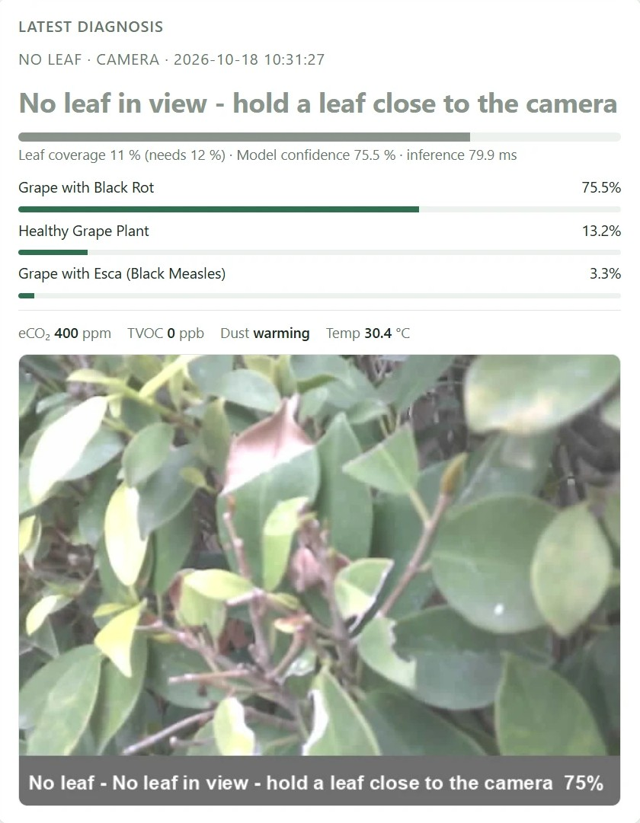
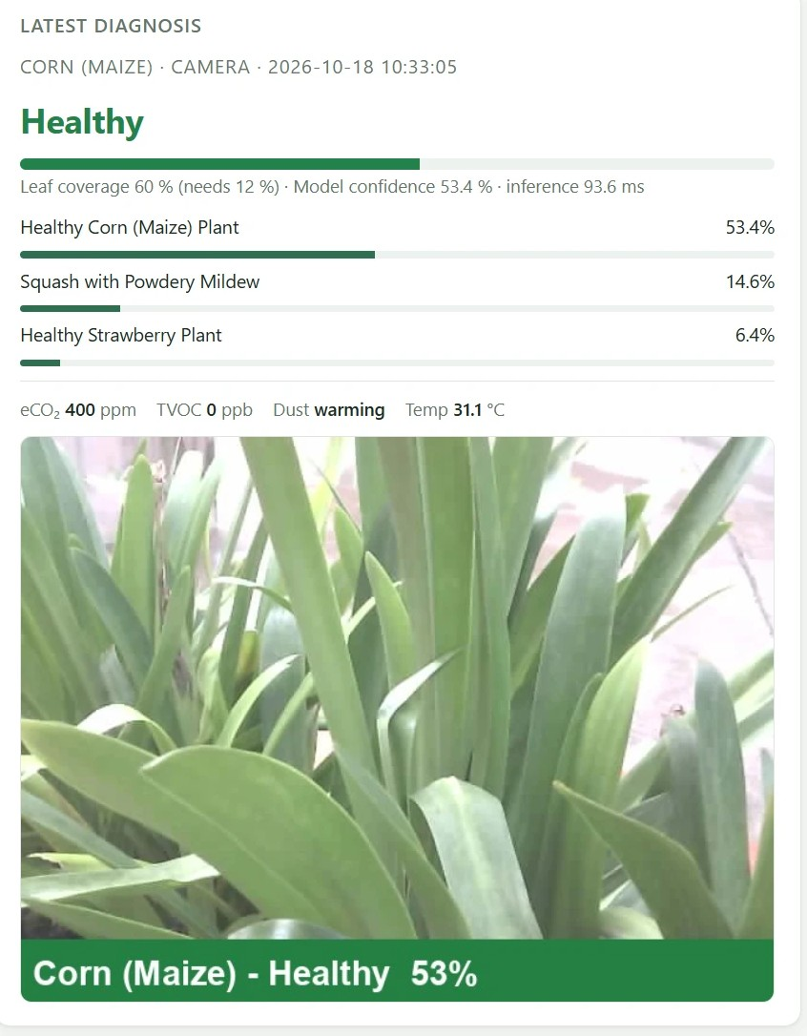
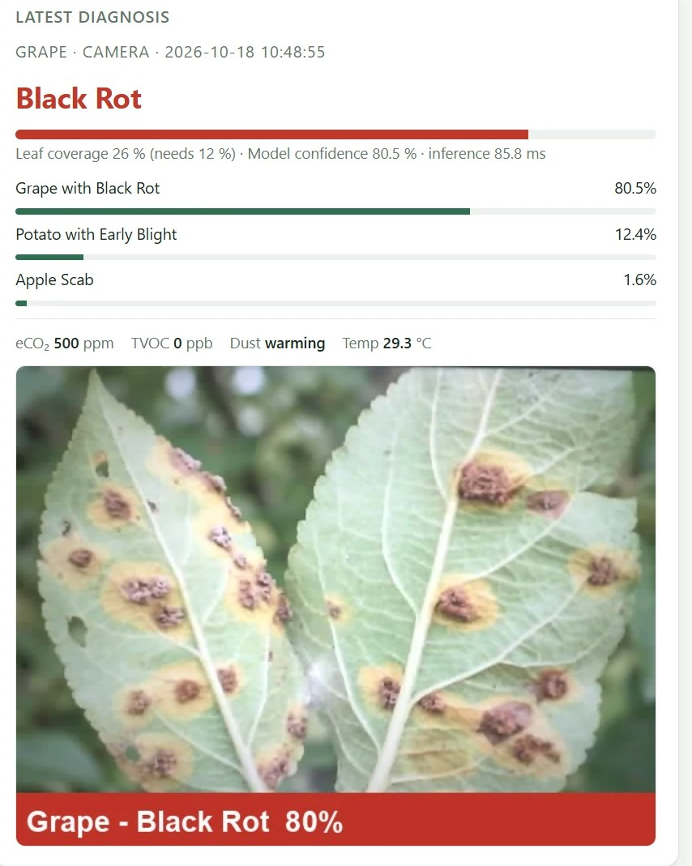
Live Scans Outdoors with the Robot's Camera
Hedge at ~1 m: no leaf in view
Potted plant: low confidence
Spotted leaves: flagged
11 % coverage, so the model's 75.5 % “black rot” is withheld
60 % coverage; “healthy corn” at 53.4 %, just above the 50 % threshold
26 % coverage; “grape black rot” at 80.5 %, readings saved with the image
Washed-out camera colours put some real foliage near the 12 % threshold; holding the leaf close fixes it.
Notes:
[45 s]
These are three outdoor scans with the robot's camera on 18 October.
- Left, a hedge from about a metre away. Only 11 percent of the frame was leaf-coloured, just under the threshold, so the model's 75.5 percent "black rot" was withheld and the user is asked to bring a leaf closer.
- Middle, a potted plant outside the training set. It passed with 60 percent coverage, but the label "healthy corn" came at only 53.4 percent, just above our 50 percent threshold. We did not identify the plant independently, so we do not count this as right or wrong. The low confidence is the warning sign.
- Right, a photograph of spotted leaves on a screen, flagged as black rot at 80.5 percent, with the sensor readings saved alongside the image.
The ESP32-CAM's washed-out colours put some real foliage close to the threshold. Holding the leaf close fixes that.

Slide 30
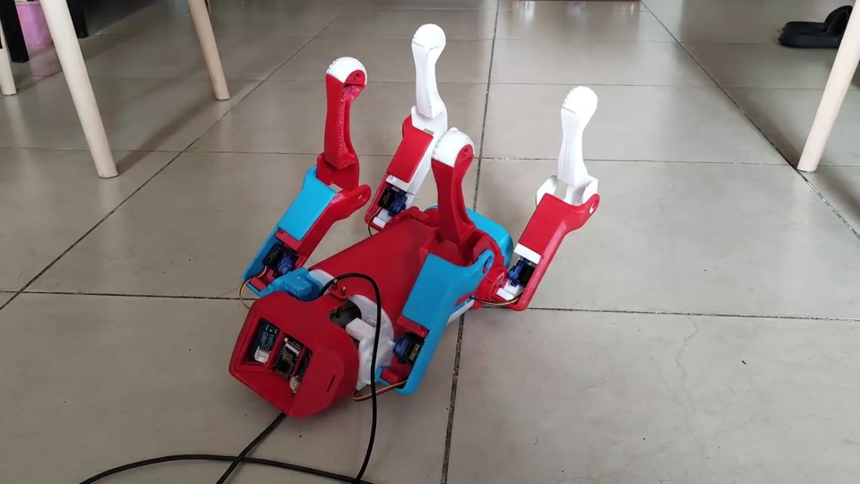
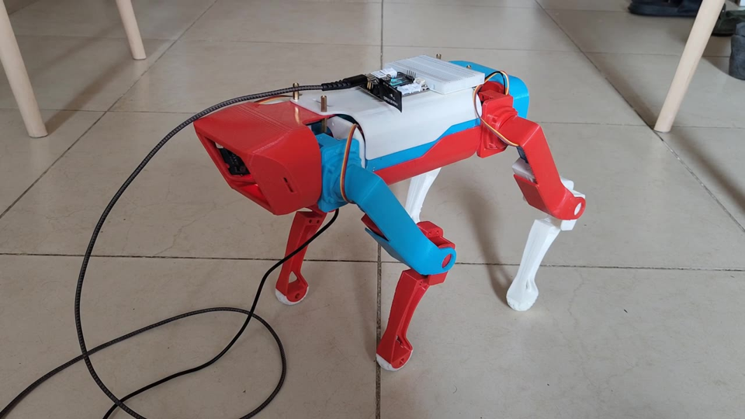
Actuation Trials on the Physical Robot
On its back: all four legs follow their commanded angles
Standing: supports its weight and shifts its legs, but weakly
Why it is weak
Stance knee torque is 36–52 % of a genuine MG996R's rating and rises when a leg lifts; copies deliver less, and a sagging supply cuts torque further.
Next step
Dedicated 6 V servo supply, CoM-centred footholds and straighter legs (a taller stance); stronger servos if the margin is still thin.
Notes:
[60 s — play both clips]
These are our first actuation trials on the printed robot.
- Left, the robot on its back, so the servos carry only the legs. All four legs move through their commanded angles. That confirms the servo wiring, the joint directions and the control signals.
- Right, standing on its own feet. It holds its weight and shifts its legs and body, but the motion is slow, small and visibly strained, and it does not take a step.
This matches our analysis. In a four-foot stance, the knee needs 36 to 52 percent of a genuine MG996R's rated torque, and more when a leg lifts and the other legs take its share. Inexpensive copies of the MG996R often deliver less than rated, and twelve servos moving together draw several amps, so a sagging supply cuts the torque further.
Next steps, in order of cost:
1. A dedicated 6-volt servo supply.
2. Footholds centred on the centre of mass, from the simulation.
3. A taller stance with straighter legs, which shortens the knee's lever arm: about 76 mm at 180 mm height, 43 mm at 220 mm.
4. Stronger servos if the margin is still too thin.
If asked:
- "Which is it, the servos or the supply?" We have not yet separated the two by measurement. That is the first future-work item.

Slide 31
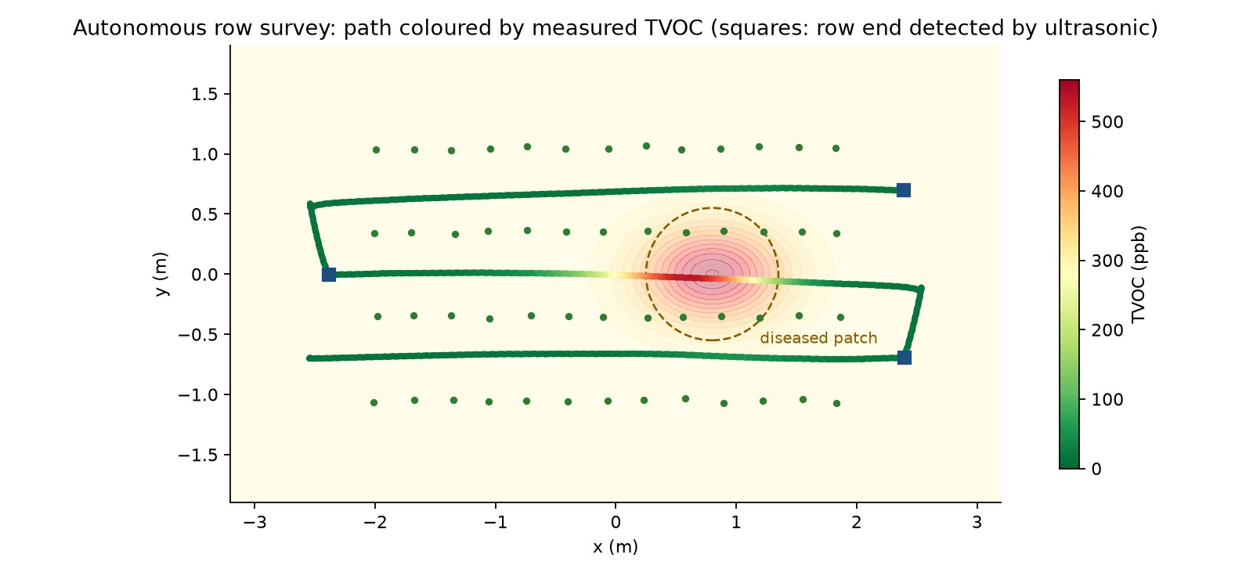
Simulated Autonomous Field Survey
16.7 m
in 129 s: all three row gaps, no falls
3 / 3
row ends detected by the ultrasonic sensor
≤ 2.7°
body tilt; a servo at its limit 1.3 % of the time
Route coloured by measured TVOC over the modelled VOC field; squares mark row ends detected by the front ultrasonic sensor
535 ppb
TVOC peak, 0.2 m from the source (sensor lag)
Notes:
[45 s]
This is the result of the full simulated survey.
The robot walked 16.7 metres in 129 seconds and covered all three row gaps with no falls. The front ultrasonic detected all three row ends. Body tilt stayed under 2.7 degrees, and a servo was at its torque limit only 1.3 percent of the time.
The route is coloured by measured TVOC, and it turns red over the stressed patch. The peak was 535 ppb, but it sits 0.2 metres from the true source. The reason is that the gas sensor responds with about a 2.5-second lag while the robot keeps walking, so the peak is smeared along the path. This is a real effect worth planning for: pausing at waypoints or correcting for the sensor's known response would fix it.

Slide 32
Gait Stability and the Servo Speed Limit
0.18 m/s
usable ceiling with MG996R servos; tracks the command within 7 % from 0.08 m/s up
Centre of mass 12 mm aft With footholds centred on the body, all 24 gait settings fell within 0.8–3.0 s. Centred on the measured centre of mass, the trot held tilt below 0.7°.
Notes:
[50 s]
These are two findings that matter for the real robot.
- Left chart, commanded against achieved speed. From 0.08 to 0.18 metres per second the robot tracks the command within 7 percent. Above that the achieved speed collapses.
- Middle chart, how often a servo is at its torque limit. It stays at 8 to 34 percent up to 0.18 metres per second, then jumps to 68 percent at 0.20, and the robot falls at 0.22. So the usable ceiling with MG996R servos is about 0.18 metres per second.
- Bottom, the centre-of-mass finding. With footholds centred on the body, every one of 24 gait settings fell within 0.8 to 3 seconds. Centred on the measured centre of mass, tilt stayed below 0.7 degrees.
If asked:
- "Why does 0.24 look better than 0.22?" It stayed upright but reached only 0.166 m/s with 77 percent saturation, so it is not usable either.

Slide 33
Outcome Against Review III Expectations
Review III expectation | Outcome | Interpretation
Onboard inference on a Jetson | Inference on a laptop over Wi-Fi | Cheaper and safer; depends on the network link
Above 90 % disease accuracy (literature figure) | Functional demonstration; field accuracy not measured | Lab-trained models are expected to drop on field images
Static torque margin is thin | Confirmed in simulation (0.18 m/s ceiling) and on hardware | Analysis, simulation and robot agree
Walking robot with sensing | Robot stands and moves its legs; walking shown in simulation | Hardware walking is the next phase
Environmental sensing payload | Gas, dust, temperature live; ultrasonic firmware ready | Sensing payload essentially complete
Notes:
[40 s]
Comparing honestly with what we planned at Review III:
- Onboard inference on a Jetson became laptop inference over Wi-Fi. It is cheaper and safer, but depends on the network.
- We cited above 90 percent accuracy from the literature. We did not measure field accuracy; our classification is a functional demonstration.
- The Review III torque analysis said the margin was thin. The simulation confirmed it, with a 0.18 m/s ceiling, and so did the hardware.
- A walking robot: it stands and moves its legs, and walking is shown in simulation. Walking on hardware is the next phase.
- The sensing payload is essentially complete.

Slide 34

Innovation and Relevance
05
What is new, whether it is feasible and affordable, how it is used responsibly, and where it goes next
Notes:
[5 s]
Now what is new, and why it matters in practice.

Slide 35

Contributions
Legged platform with a crop-sensing payload
Vegetation gate for a closed-set classifier
A printed 12-DOF quadruped carrying two Wi-Fi sensing nodes for gas, dust, temperature, range and video
A simple, explainable leaf check that stops confident disease reports for frames without a plant
Locomotion validated with real servo limits
Design rules for printed quadrupeds
A MuJoCo model from measured geometry, torque capped at MG996R stall, completing an autonomous row survey
Centre footholds on the measured centre of mass (12 mm aft); expect about 0.18 m/s from MG996R servos
Notes:
[45 s]
We see four contributions.
1. A legged platform with a crop-sensing payload: a printed quadruped carrying two Wi-Fi nodes for gas, dust, temperature, range and video.
2. A vegetation gate for a closed-set classifier: a simple, explainable leaf check that stops confident disease reports on frames with no plant.
3. Locomotion validated against real servo limits: a physics model built from measured geometry, with torque capped at MG996R stall, completing an autonomous row survey.
4. Design rules for printed quadrupeds: centre the footholds on the measured centre of mass, and expect about 0.18 metres per second from MG996R-class servos. These apply to anyone building a SpotMicro-type robot.

Slide 36
Cost and Feasibility
≈ ₹10,250
total purchased and listed cost of the platform
Reported cost of research quadrupeds
Platform | Reported cost
Stanford Doggo [2] | < US$3,000
MIT Cheetah 3 [1] | ~US$50,000+
ANYmal [4] | US$100,000+
The XIAO, sensors, resistors and cables were already available to the team and are not costed.
Notes:
[40 s]
On cost: the purchased and listed parts come to about ₹10,250, made up of:
- ₹5,200 for printing.
- ₹3,996 for twelve servos.
- ₹689 for the ESP32-CAM.
- ₹249 for a servo driver.
- ₹119 for the camera programmer.
The XIAO, the sensors and the wiring were already available to the team, so they are not costed here.
For comparison, the surveyed papers report Stanford Doggo under 3,000 US dollars, MIT Cheetah 3 around 50,000, and ANYmal over 100,000.
So the approach is within reach of a student lab, and potentially a small farm. The trade-off is lower performance, which we have quantified.

Slide 37






Ethical and Responsible Use
Data stays local
No false certainty
Electrical and physical safety
All readings and images stay on the laptop's own hotspot; no cloud service, no personal data, camera aimed at crops
Gate and 50 % threshold suppress unreliable labels; results are indications for an agronomist, not a spray decision
Low-voltage USB payload, no LiPo on board, slow-moving robot, separate servo supply
Honest sensor claims
Open source and attribution
Built for small farms
eCO₂ is estimated and the dust sensor uncalibrated; used for trends and alerts, not regulatory values
SpotMicro design credited under CC-BY; our code and print files are public
Low-cost parts and no internet needed, so the approach is within reach of smallholders
Notes:
[50 s]
The rubric asks about ethics. These are design choices we made deliberately.
- Data stays local. Everything stays on the laptop's own hotspot: no cloud, no personal data, and the camera points at crops.
- No false certainty. The gate and the 50 percent threshold suppress unreliable labels, and the results are presented as indications for an agronomist, not a spray decision. Over-spraying because of a false diagnosis would harm crops and the environment.
- Safety. The payload runs on low-voltage USB, there is no LiPo on board, and the robot is slow.
- Honest sensor claims. eCO2 is estimated and the dust sensor is uncalibrated, so we use them for trends and alerts, not regulatory values.
- Open source with attribution. The SpotMicro design is credited under its CC-BY licence, and our code is public.
- Accessibility. Low-cost parts and no internet requirement put it within reach of smallholders.

Slide 38

Practical Applicability
Row-by-row scouting
What a farm needs to run it
Walk the rows, log gas, dust and temperature, and scan suspicious leaves on the way
A laptop with Wi-Fi hotspot
The robot with its two nodes
A USB power bank
Any phone to view the dashboard
No internet, no cloud account
Early-warning hotspots
Rising VOC readings along a row point to stressed plants before symptoms spread
Nurseries and greenhouses
Repeated inspection of seedlings in narrow aisles where wheels struggle
Records for agronomists
Dashboard address
http://192.168.137.1:5000
Tagged images with the conditions at capture give an evidence trail for advice
Notes:
[35 s]
In practice, it could be used for:
- Row-by-row scouting: walking the rows, logging air conditions, and scanning suspicious leaves on the way.
- Early-warning hotspots: rising VOC readings along a row point to stressed plants before symptoms spread.
- Nurseries and greenhouses: repeated inspection in narrow aisles where wheels struggle.
- Records for agronomists: each image is tagged with the conditions at capture, which gives an evidence trail.
To run it, a farm needs only a laptop with a hotspot, the robot, a USB power bank, and any phone to view the dashboard. No internet or cloud account is needed.

Slide 39
Limitations
Limitation | Effect | How it is handled
Real servos lack torque reserve | Robot stands and moves its legs but does not step | Dedicated supply, CoM footholds, taller stance, stronger servos
Classifier trained on lab photos, 14 crops | Lower accuracy on field images; any plant passes the gate | Gate and 50 % threshold; fine-tuning on field images
Washed-out ESP32-CAM colours | Some real foliage falls below the 12 % threshold | Hold the leaf close; tune the threshold to this camera
eCO₂ estimated; PPD42 uncalibrated | Relative readings, not regulatory values | Used for trends and alerts
Simulated fields are modelled | Simulation shows the method, not field data | Hardware sensors validated on the bench
Notes:
[45 s]
We want to state the limitations ourselves.
- The real servos lack torque reserve, so the robot stands but does not step. We have a clear fix path.
- The classifier was trained on lab photos of 14 crops, so accuracy on field images will be lower, and any plant passes the gate, even an untrained crop.
- The ESP32-CAM's washed-out colours put some real foliage near the 12 percent threshold. The threshold should be tuned to this camera.
- eCO2 is estimated and the PPD42 is uncalibrated, so the readings are relative.
- The gas and dust fields in the simulation are modelled, so the simulation demonstrates the method rather than field data.

Slide 40
Future Work
01
Walking on hardware
Dedicated 6 V servo supply; measure torque and voltage under load; CoM footholds and a taller stance; step in place, then walk below 0.18 m/s
02
Complete the sensor set
Wire both ultrasonic sensors; add a soil-moisture probe; calibrate gas and dust against reference instruments
03
Act on measurements
Grove relay to switch an irrigation pump or raise a gas alarm from the dashboard
04
Field-ready classification
Fine-tune on images from the robot's camera; replace the colour gate with a learned open-set detector
05
Mapping and autonomy
Compensate for the SGP30's lag; log positions to build field maps; battery for untethered runs
Notes:
[40 s]
Future work, in order of what it unlocks:
1. Walking on hardware. A dedicated 6-volt servo supply, measuring torque and voltage under load, then the centre-of-mass footholds and a taller stance. Then stepping in place, and walking below 0.18 metres per second.
2. Complete the sensor set. Wire the ultrasonic sensors, add a soil-moisture probe, and calibrate against reference instruments.
3. Act on measurements. Use the Grove relay we have to switch an irrigation pump or raise an alarm from the dashboard.
4. Field-ready classification. Fine-tune on images from the robot's own camera, and replace the colour gate with a learned open-set detector.
5. Mapping and autonomy. Correct for the gas sensor's lag, log positions to build field maps, and add a battery for untethered runs.

Slide 41
Conclusion
Sensing works end to end
Two wireless nodes, a live dashboard with logging, and leaf-disease classification that refuses to guess without a leaf
Locomotion validated in physics
A full autonomous row survey without a fall, with servos capped at their real torque
The printed robot moves
All twelve servos drive the legs and it stands, with too little torque reserve to step, as predicted
Design rules for the next build
Centre footholds on the centre of mass; expect about 0.18 m/s from MG996R servos
Repository github.com/AdithyaSM31/Precision-Agriculture-Monitoring-Quadruped-Robot-Dog
Notes:
[40 s]
To conclude:
- The sensing works end to end: two wireless nodes, a live dashboard with logging, and leaf-disease classification that refuses to guess without a leaf.
- Locomotion is validated in physics: a full autonomous row survey without a fall, with servos capped at their real torque.
- The printed robot moves: all twelve servos drive the legs and it stands, though with too little torque reserve to step, exactly as our analysis predicted.
- We leave two design rules for the next build: centre the footholds on the centre of mass, and expect about 0.18 metres per second from MG996R servos.
All the code, print files and results are on GitHub. Thank you. We are happy to take questions.

Slide 42
References
[1] Bledt, G., et al. (2018). MIT Cheetah 3: Design and Control of a Robust, Dynamic Quadruped Robot. IEEE/RSJ IROS. DOI: 10.1109/IROS.2018.8593885
[2] Kau, N., et al. (2019). Stanford Doggo: An Open-Source, Quasi-Direct-Drive Quadruped. IEEE ICRA. DOI: 10.1109/ICRA.2019.8794436
[3] Katz, B., et al. (2019). Mini Cheetah: A Hardware Design for Extremity Locomotion. IEEE ICRA. DOI: 10.1109/ICRA.2019.8793865
[4] Hutter, M., et al. (2016). ANYmal — A Unique Quadruped Robot for Autonomous Operation. IEEE/RSJ IROS. DOI: 10.1109/IROS.2016.7758092
[5] Ding, Z., et al. (2021). Learning to Walk on Uneven Terrain for Quadrupedal Robots using RL. IEEE Transactions on Robotics, 37(4), 1120–1134.
[6] Bellicoso, C. D., et al. (2018). Dynamic Locomotion Through Online Nonlinear MPC for Quadrupedal Robots. IEEE Robotics and Automation Letters, 3(4). DOI: 10.1109/LRA.2018.2848303
[7] Fehlmann, S., et al. (2023). Precision Agriculture Using Autonomous Ground Robots: A Review. Springer Precision Agriculture, 24(2), 520–549.
[8] Roldán, J. J., et al. (2018). Robots in Agriculture: State of the Art and Future Directions. Computers and Electronics in Agriculture, 146, 76–89.
[9] Bogue, R. (2016). Robots in Agriculture: State of the Art and Future Directions. Industrial Robot, 43(1), 1–6.
[10] Vasconez, J. P., et al. (2020). Human–Robot Interaction in Agriculture: A Survey and Review. Computers and Electronics in Agriculture, 175, 105500.
[11] Mohanty, S. P., et al. (2016). Using Deep Learning for Image-Based Plant Disease Detection. Frontiers in Plant Science, 7, 1419. DOI: 10.3389/fpls.2016.01419
[12] Ferentinos, K. P. (2018). Deep Learning Models for Plant Disease Detection and Diagnosis. Computers and Electronics in Agriculture, 145, 311–318.
[13] Too, E. C., et al. (2019). A Comparative Study of Fine-Tuning Deep Learning Architectures for Plant Disease Identification. Computers and Electronics in Agriculture, 161, 272–279.
[14] Chen, J., et al. (2020). Using Deep Transfer Learning for Image-Based Plant Disease Identification on Embedded Devices. Computers and Electronics in Agriculture, 176, 105653.
[15] Saleem, M. H., et al. (2019). Plant Disease Detection and Classification by Deep Learning: A Review. Computers and Electronics in Agriculture, 164, 104902.
[16] Ray, P. P. (2017). Internet of Things for Smart Agriculture: Technologies, Practices and Future Direction. Journal of Ambient Intelligence and Smart Environments, 9(4), 395–420.
[17] Elijah, O., et al. (2018). An Overview of Internet of Things (IoT) and Data Analytics in Smart Agriculture. IEEE Internet of Things Journal, 5(5), 3758–3773.
[18] Bacco, M., et al. (2019). Smart Farming: Technologies, Applications and Challenges. Computers and Electronics in Agriculture, 164, 104908.
[19] S. Savary et al. (2019). The global burden of pathogens and pests on major food crops. Nature Ecology & Evolution, 3(3), 430–439.
[20] D. P. Hughes and M. Salathé (2015). An open access repository of images on plant health to enable the development of mobile disease diagnostics. arXiv:1511.08060.
[21] M. Sandler et al. (2018). MobileNetV2: Inverted residuals and linear bottlenecks. Proc. IEEE/CVF CVPR, 4510–4520.
[22] E. Todorov, T. Erez and Y. Tassa (2012). MuJoCo: A physics engine for model-based control. Proc. IEEE/RSJ IROS, 5026–5033.
[23] D. M. Woebbecke et al. (1995). Color indices for weed identification under various soil, residue, and lighting conditions. Trans. ASAE, 38(1), 259–269.
[24] KDY0523 (2018). SpotMicro – robot dog. Thingiverse 3445283, CC-BY.
Notes:
Reference list: papers 1–18 are the surveyed literature; 19–24 are the sources for crop-loss figures, the dataset, MobileNetV2, MuJoCo, the colour-index idea behind the gate, and the SpotMicro design. Skip this slide in the talk unless asked.

Slide 43
Thank you
Questions and live demonstration
Adithya Sankar Menon · Siddhesh Pushkraj Shinde · Rachit Gupta
Guide: Dr. Lakshmanan K
Notes:
Questions.
Likely questions and short answers:
- "Why ESP32 and not a Raspberry Pi?" Lower cost and power, and nothing expensive at risk in a fall. The laptop does the heavy computation.
- "How accurate is the classifier?" On PlantVillage-style images it is high, as the literature reports. We did not measure field accuracy. Our contribution is guarding it with the gate and the confidence threshold.
- "Why HSV thresholds and not another network?" They are simple and explainable, need no training data, and fix the most visible failure. A learned open-set detector is future work.
- "Why does the real robot not walk?" Thin torque margin, predicted at Review III and confirmed in simulation. Next comes a dedicated supply, CoM footholds and a taller stance.
- "What is the novelty?" The integration of a printed legged platform with crop sensing, the gate, and quantified design rules for hobby quadrupeds.
- "What did you personally do?" Be ready to describe your own modules in one or two sentences each.

Slide 44
Literature Review, Papers 1–6
# | Authors and year | Title | Key contribution | Research gap
1 | Bledt et al. (2018) | MIT Cheetah 3: Design and Control of a Robust, Dynamic Quadruped Robot | Designed high-torque density proprioceptive actuators and Model Predictive Control (MPC) for dynamic walking over rough terrain without vision. | High cost (~$50k+), complex custom planetary gearing, no environmental/agricultural sensing payload.
2 | Kau et al. (2019) | Stanford Doggo: An Open-Source, Quasi-Direct-Drive Quadruped | Developed an open-source 3D-printed quadruped platform using quasi-direct drive brushless motors for dynamic bounding. | Optimized purely for acrobatic jumps/speed; lacks on-board compute for perception and has <10 min battery life.
3 | Katz et al. (2019) | Mini Cheetah: A Hardware Design for Extremity Locomotion | Modular 3-DOF leg design using low-cost backdrivable BLDC motors enabling agile omnidirectional gaits. | Focuses strictly on mechanical agility in laboratory environments; no autonomous navigation or edge AI pipeline.
4 | Hutter et al. (2016) | ANYmal - A Unique Quadruped Robot for Autonomous Operation in Harsh Environments | Industrial-grade quadruped with series elastic actuators (SEAs) and IP67 ruggedized body for outdoor inspection. | Prohibitively expensive ($100k+), heavy industrial form-factor unsuitable for smallholder precision farming.
5 | Ding et al. (2021) | Learning to Walk on Uneven Terrain for Quadrupedal Robots using Reinforcement Learning | Trained neural network locomotion policies in simulation (Isaac Gym) with robust sim-to-real transfer over rugged slopes. | High computational training overhead; policy does not integrate multi-sensor agronomic payloads or path tracking.
6 | Bellicoso et al. (2018) | Dynamic Locomotion Through Online Nonlinear Model Predictive Control for Quadrupedal Robots | Real-time ZMP and CoM trajectory optimization enabling adaptive crawl and trot gaits over unmodeled obstacles. | Requires high-end x86 computer boards; difficult to run concurrently with edge vision models on low-power platforms.
Notes:
Backup slides: the full 18-paper survey from Review III, for questions on prior work.

Slide 45
Literature Review, Papers 7–12
# | Authors and year | Title | Key contribution | Research gap
7 | Fehlmann et al. (2023) | Precision Agriculture Using Autonomous Ground Robots: A Review | Systematic review of wheeled and tracked agricultural rovers for weed control, phenotyping, and soil sampling. | Identifies severe mobility failure of wheeled rovers in wet mud, soft soil, and high-crop canopy furrows.
8 | Roldán et al. (2018) | Mini-UAVs and Mobile Robots for Precision Agriculture: A Review of Multi-Robot Systems | Analyzed complementary roles of aerial drones (macro-surveys) and ground robots (micro-inspection). | Highlighted drone limitations: 20-min flight time, inability to inspect leaf undersides, and blind spots beneath crop canopies.
9 | Bogue, R. (2016) | Robots in Agriculture: State of the Art and Future Directions | Surveyed commercial adoption of agricultural robotics, highlighting high ROI in crop health monitoring. | Commercial units are bulky, heavy, cause soil compaction, and require flat structured greenhouse tracks.
10 | Vasconez et al. (2020) | Human–Robot Interaction in Agriculture: A Survey and Review | Investigated telemetry, UX dashboards, and safety mechanisms for farmer-robot interfaces in open fields. | Found most agricultural robotic interfaces are academic prototypes lacking real-time edge telemetry and alert maps.
11 | Mohanty et al. (2016) | Using Deep Learning for Image-Based Plant Disease Detection | Trained AlexNet and GoogLeNet on 54,306 images across 26 diseases with 99.35% classification accuracy. | Tested only on static laboratory-controlled leaf images with uniform backgrounds; lacks edge device deployment.
12 | Ferentinos, K. P. (2018) | Deep Learning Models for Plant Disease Detection and Diagnosis | Evaluated VGG, ResNet, and AlexNet on 87,848 leaf images with real-world noise variations (99.5% accuracy). | High parameter count (VGG/ResNet) causes severe latency and memory bottlenecks on embedded single-board computers.

Slide 46
Literature Review, Papers 13–18
# | Authors and year | Title | Key contribution | Research gap
13 | Too et al. (2019) | A Comparative Study of Fine-Tuning Deep Learning Architectures for Plant Disease Identification | Benchmarked MobileNetV2, DenseNet-121, and InceptionV3; proved MobileNetV2 achieves 97.4% accuracy with 10× fewer FLOPs. | Did not perform hardware-specific quantization (TensorRT / ONNX) or test real-time video stream ingestion.
14 | Chen et al. (2020) | Using Deep Transfer Learning for Image-Based Plant Disease Identification on Embedded Devices | Deployed lightweight CNN on Raspberry Pi 3B+ using INT8 quantization, achieving 12 FPS at 92.1% accuracy. | Insufficient FPS for continuous mobile robot navigation; no integration with robotic gait or sensor fusion.
15 | Saleem et al. (2019) | Plant Disease Detection and Classification by Deep Learning: A Review | Comprehensive meta-analysis of deep learning architectures, dataset biases, and real-time field challenges. | Concluded that field-ready solutions require mobile ground robots that bring cameras within 0.5m of plant leaves.
16 | Ray, P. P. (2017) | Internet of Things for Smart Agriculture: Technologies, Practices and Future Direction | Proposed layered IoT architecture for soil moisture, microclimate, and particulate monitoring in precision farming. | Relied exclusively on stationary sensor nodes (motes), creating spatial coverage gaps across large farm tracts.
17 | Elijah et al. (2018) | An Overview of Internet of Things (IoT) and Data Analytics in Smart Agriculture | Investigated wireless sensor networks (WSNs) and cloud data pipelines for environmental anomaly detection. | High infrastructure cost of deploying hundreds of stationary nodes; vulnerable to field vandalism and weather damage.
18 | Bacco et al. (2019) | Smart Farming: Technologies, Applications and Challenges in Precision Agriculture | Explored multi-sensor data fusion (temperature, humidity, organic gases, optical imagery) for soil health profiling. | Lacked mobile autonomous platforms to transport multi-sensor payloads dynamically throughout crop rows.

